Slide 1



BANKING MANAGEMENT system
Project by:
Amrutha TA
Ashwini R
Anuj Kumar Yadav
Harshavardhan Darekar
Sanju KS

Slide 2

Contents
Introduction
Objectives
Proposed System
Requirements
Architecture Diagram
Features
Output Snapshots
Conclusion

Slide 3



Introduction
The bank management system is a webapp that keeps track of a client’s bank account. This demonstrates the operation of a banking account system and covers the essential functions of bank management software.

Slide 4
Objectives
The system manages account holder’s information with their transaction details.
Provide easy and less time consuming solution.
Providing an user-friendly interface to handle their bank account.
The deposit/withdrawal of money by a customer take place in a single step process where one can choose their option and also balance amount in an account can be retrieved.

Slide 5



requirements
Hardware Requirements
Processor: Intel 5 System
Speed: 250 to 833 MHz
Storage space
Software Requirements
CodeBlocks
Xampp Server
MySQL

Slide 6
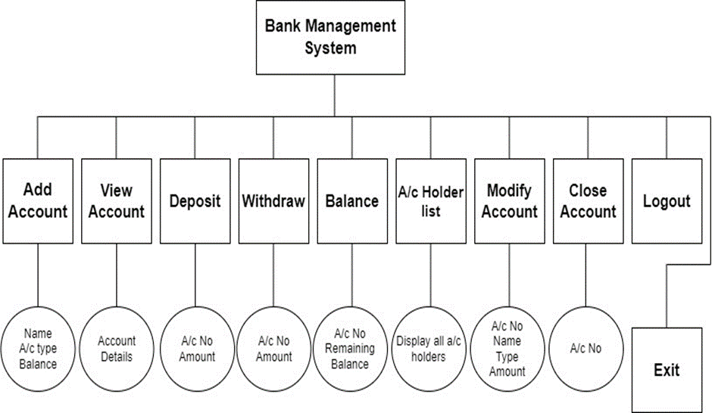
Architecture Diagram

Slide 7
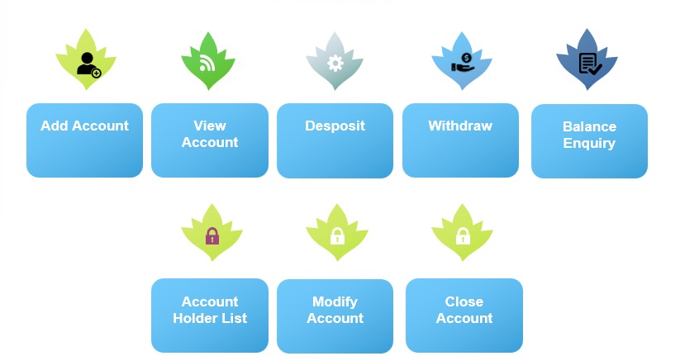
Features

Slide 8
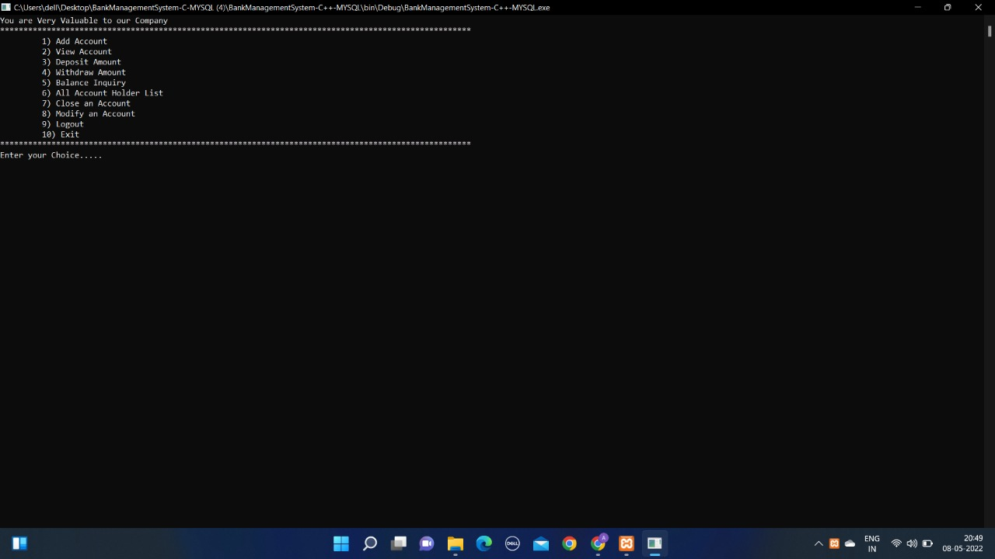
Output Snapshots

Slide 9
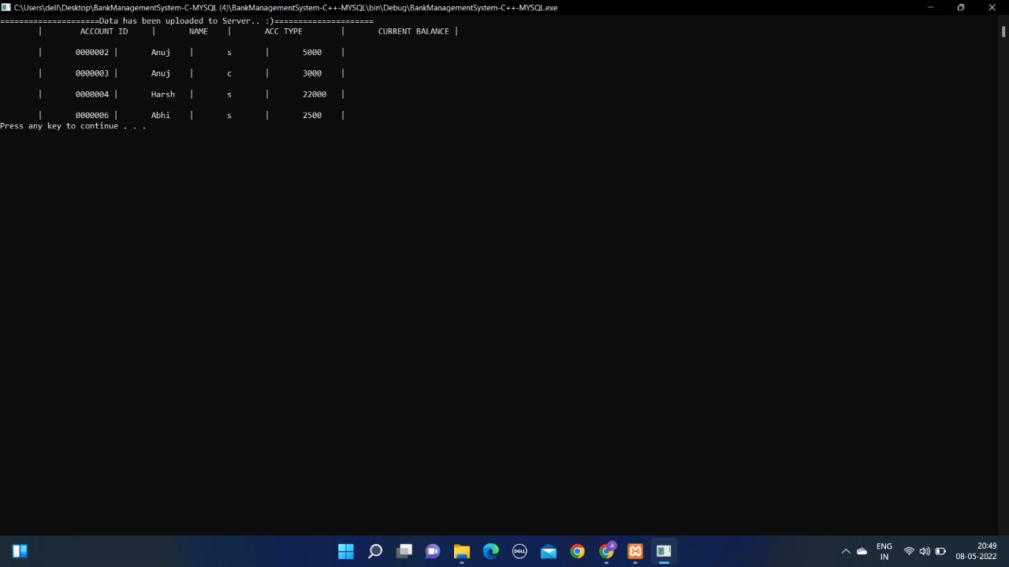

Slide 10
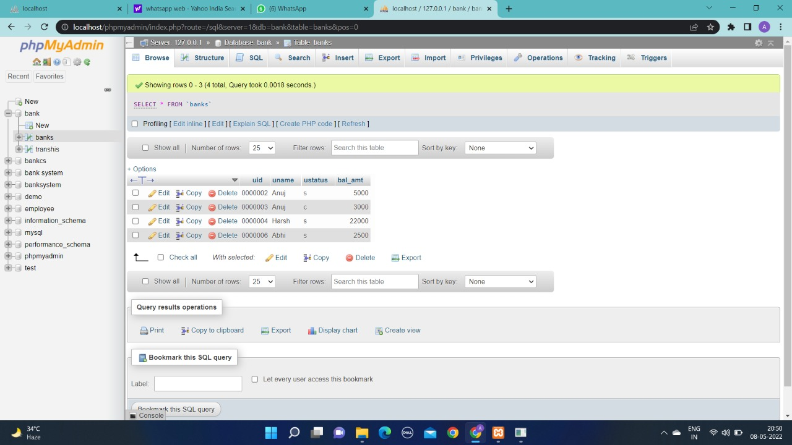
Database snapshot

Slide 11
conclusion
The proposed system will be a database-driven website where services will be provided to customer and will be stored in a database.
The customer can select various plans for deposits/withdrawal, prepaid, post-paid services, bill payment etc. From the menu given and data stored in the database will be displayed.
From this system, customers time will be saved and decision making will be easier and services will be provided effectively.

Slide 12

Any Questions

Slide 13
Thank you

